Slide 1
Data Analysis I: Statistics
XBUS-504: Georgetown Data Science Certificate
Eric Harley
Fall 2018

Slide 2
Certificate Program Course Schedule
Foundations of Data Analytics and Data Science
Software Engineering for Data
Data Sources and Storage
Data Ingestion and Wrangling
Data Analysis I: Statistics
Data Analysis II: Machine Learning
Visual Analytics
Applied Data Analytics
Notes:
Quick overview of

Slide 3
Certificate Program Course Schedule
Foundations of Data Analytics and Data Science
Software Engineering for Data
Data Sources and Storage
Data Ingestion and Wrangling
Data Analysis I: Statistics
Data Analysis II: Machine Learning
Visual Analytics
Applied Data Analytics
YOU ARE HERE
Notes:
We’re going to be talking about things that are largely about statistics, and we will be trying to tie this back to other areas as we go

Slide 4
Some Logistics
Email me: eric.harley@georgetown.edu
Include:
Your name, email address, birthday (month, day)
Why are you taking this course?
What do you hope to get out of this course?
Your Github, LinkedIn urls
Notes:
Important!! I want to hear from you, make sure I have your contact information and we can connect professionally. I want to hear more about what your capstone project is and how you’re doing and where we can help.

Slide 5
Goals for this Course
This course reviews the basics of descriptive and inferential statistics, distributions, probability, and regression with a specific focus on application to real data sets.
Course Objectives
Explain descriptive and inferential statistics.
Compute probabilities, measures of central tendency, and variance.
Produce and interpret meaningful and accurate summary statistics.
Conduct hypothesis tests and understand Type I and Type II errors.
Develop single and multivariate regression models.
Differentiate between correlation and causation.
Notes:
the course description

Slide 6

Who Am I?
Eric Harley
Cyber Security Researcher at
The MITRE Corporation
LinkedIn: linkedin.com/in/eharley
Github: github.com/ericharley
Email: eric.harley@georgetown.edu
Notes:
Undergraduate degree in mathematics, long term interest in computer science
Went to grad school for combinatorics, ended up in statistics and migrated into data science
Have worked a lot professionally in cybersecurity, but do a lot of other things as well.

Slide 7
Agenda: Session I
Morning:
Introduction to Statistics, Big Picture
Describing Data (Graphical, Numerical)
Lunch
Probability
Introduction to Inference
Notes:
We’re going to get back to our big picture introduction to statistics, statistical thinking
We’ll get into the most useful stuff which is working with our data

Slide 8
Agenda: Session II
Morning:
Introduction to Inference
Confidence Intervals
Hypothesis Testing
Lunch
Regression
Optional
Goodness of Fit, Nonparametric Statistics

Slide 9
< Pause >
Thoughts and Questions?

Slide 10
What is “Statistics” Anyway?
Notes:
Statistics is a way of knowing. Statistics is a toolbox for the data scientist
Your job is to use these tools to explore and understand your data and the world around you. Over time you will become more practiced in using these tools.

Slide 11
Examples of Statistics
Mark Trumbo has a lifetime OBP of .301
People tend to be more persuasive when they look others directly in the eye and speak loudly and quickly.
Women make 75 cents to every dollar a man makes at the same job.
Eating egg whites can increase life span.
Notes:
Statistics are everywhere.
Statistics are often included in reports to add credibility. This is easily observed watching any of the major news shows. Many of the statistics presented to you in your life have not been, are not, and will not be accurate. These snappy numbers are often easily accepted and mislead people, especially people who are not informed about research and statistics.
It is extremely important to understand statistics because statistics influence which findings you are going to believe and which findings are going to influence you to make changes in your life.

Slide 12
Examples of Statistics
How long will it take to fill a job opening?
What fraction of employees will accept a 401k plan offering?
When will a new electric car first fail?
Who would be elected President of the United States?
What proportion of new mortgage loans that will default?
What’s the number of job gains in the U.S.?
What’s the likelihood of finding oil in a plot of land?
Notes:
Statistics are everywhere.
Statistics are often included in reports to add credibility. This is easily observed watching any of the major news shows. Many of the statistics presented to you in your life have not been, are not, and will not be accurate. These snappy numbers are often easily accepted and mislead people, especially people who are not informed about research and statistics.
It is extremely important to understand statistics because statistics influence which findings you are going to believe and which findings are going to influence you to make changes in your life.

Slide 13
“There are three kinds of lies -- lies, damned lies, and statistics.” - Benjamin Disraeli, British Prime Minister
Notes:
Benjamin Disraeli was quoted by Mark Twain as having said, "There are three kinds of lies -- lies, damned lies, and statistics." This quote reminds us why it is so important to understand statistics. From now on, don't just blindly accept numbers or findings but look carefully at the numbers, the sources, and most importantly, the procedures researchers use to obtain their findings. But just as important as detecting the deceptive use of statistics is the appreciation of the proper use of statistics.

Slide 14
Dealing with Uncertainty
Everyday decisions are based on incomplete information
Consider:
The price of IBM stock will be higher in six months than it is now.
If the federal budget deficit is as high as predicted, interest rates will remain high for the rest of the year.

Slide 15
Dealing with Uncertainty
Because of uncertainty, the statements should be modified:
The price of IBM stock is likely to be higher in six months than it is now.
If the federal budget deficit is as high as predicted, it is probable that interest rates will remain high for the rest of the year.
Notes:
Variability
Need of statistics arises from the omnipresence of variability (noise)
Repeated measurements on the same individual vary (noise)
Some times we want to find unusual individuals
Other times we focus on the variation of measurements
Other times we want to detect systematic effects against the background noise of individual variation

Slide 16
Problems Statistics Solves
Simplify and describe data.
Compares things.
Detects relationships between things.
Deduces and quantifies relationships between things.
Notes:
1. Describe data to simplify things to explain things (bottom line up front, executive summary, baseball)
2. Compare things (are they the same? are they different?)
3. Is there a relationship between things? (How does changing one thing influence another thing?)
4. What is that relationship? (regression)

Slide 17
Descriptive and Inferential Statistics
Two branches of statistics:
Descriptive statistics
Collecting, summarizing, and processing data to transform data into information
Inferential statistics
provide the bases for predictions, forecasts, and estimates that are used to transform information into knowledge

Slide 18
Key Definitions
A population is the collection of all items of interest or under investigation
N represents the population size
A sample is an observed subset of the population
n represents the sample size
A parameter is a specific characteristic of a population
A statistic is a specific characteristic of a sample

Slide 19
Population vs. Sample
Population
Sample
a b c d e f
g h I j k l m
n o p q
r s t u v
w x y z
b c
g i n
o r u
y
Values calculated using population data are called parameters
Values computed from sample data are called statistics

Slide 20
Examples of Populations
Ages of all registered voters in the United States
Incomes of all families living in Daytona Beach, FL
Annual returns of all stocks traded on the New York Stock Exchange
So, why bother with sampling?
Notes:
Time, resource constraints (HIV)
Some populations are infinite
representative of the population
sufficiently large
properly selected (for the analysis…)

Slide 21
Example: Sampling
Consider a researcher for a soft drink company who wants to determine the sweetness preferences of Americans between the ages of 15 and 25.
What’s the population?
In order for a sample to be unbiased, it must be
Representative of the population
Randomly selected
Rufficiently large
Notes:
The population in this example is finite and includes every American in this age group.
Gathering data from every individual in this population would be nearly impossible and prohibitively expensive.
’bias’ is a technical term we will revisit, what does it mean to you?

Slide 22
What about Big Data?
Yeah? What about it?
Notes:
More data doesn’t imply useful data, nor better data where one needs it (nor how to think about data outside of one’s decision area).

Slide 23

Example: Ice Cream
A new advertisement for Ben and Jerry's ice cream introduced in late May of last year resulted in a 30% increase in ice cream sales for the following three months. Thus, the advertisement was effective.
...Problems with this logic?
YES!
Ice cream consumption typically
increases in summer months
Notes:
Context matters! June, July, August

Slide 24

Example: Churches/Crime
The more churches in a city, the more crime there is. Thus, churches lead to crime.
...Problems with this logic?
YES!
Increased churches and increased crime rates can be explained by larger populations.
Notes:
A major flaw is that both increased churches and increased crime rates can be explained by larger populations. In bigger cities, there are both more churches and more crime. This problem, which we will discuss in more detail in a later chapter refers to the lurking variable problem. Namely, a third variable can cause both situations; however people erroneously believe that there is a causal relationship between the two primary variables rather than recognize that a third variable can cause both.

Slide 25

Ex: Interracial Marriages
The proportion of inter-racial marriages this year is 75% higher than it was 25 years ago. Thus, our society accepts interracial marriages.
...Problems with this logic?
YES!
What is the rate at which marriages are occurring? Are there fluctuations in the rate of interracial marriages?
Notes:
Consider the number of interracial marriages that are now occurring in our society...
A major flaw is that we don't have the information that we need. What is the rate at which marriages are occurring? Suppose only 1% of marriages 25 years ago were interracial and so now 1.75% of marriages are interracial (1.75 is 75% higher than 1). But this latter number is hardly evidence suggesting the acceptability of interracial marriages. In addition, the statistic provided does not rule out the possibility that the number of interracial marriages has seen dramatic fluctuations over the years and this year is not the highest. Again, there is simply not enough information to understand fully the impact of the statistics.

Slide 26
Ex: Interracial Marriages
Suppose only 1% of marriages 25 years ago were interracial and so now 1.75% of marriages are interracial.
Sometimes, we simply don't have the information that we need to understand the impact of statistics.

Slide 27
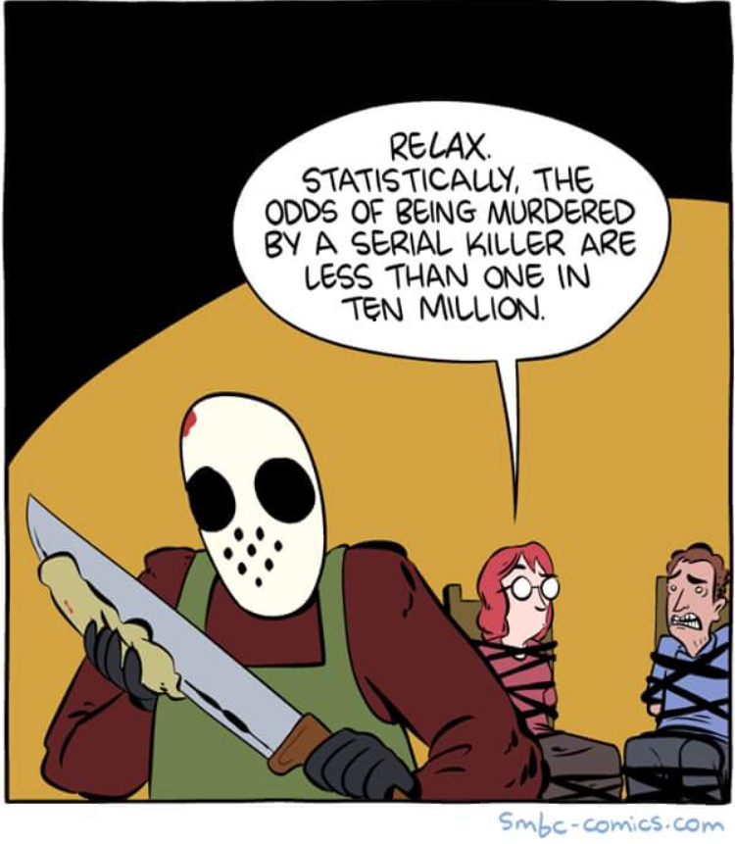

Slide 28
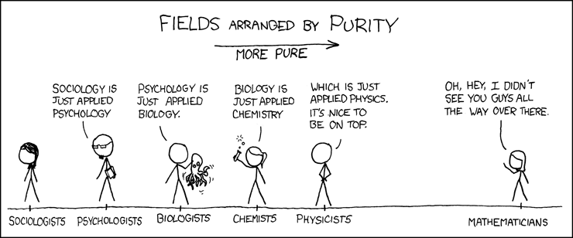
Statistical Software
XKCD “Purity”, https://xkcd.com/435/
Notes:
Statistics are NOT just facts and figures.
Statistics IS NOT mathematics. Statistics is about context. Mathematics is about the abstract and universal, what remains after removing all context.
Rather, "statistics" refers to a range of techniques and procedures for analyzing, interpreting, displaying, and making decisions based on data.

Slide 29
Statistics Aphorisms
All models are wrong, but some are useful.
- George Box
In mathematics, context obscures structure. In data analysis, context provides meaning.
- George Cobb
Mathematical theorems are true: statistical methods are sometimes effective when used with skill.
- David Moore

Slide 30
What does this have to do with data science, machine learning, etc ?
Notes:
More data doesn’t imply useful data, nor better data where one needs it (nor how to think about data outside of one’s decision area).

Slide 31
The Decision Making Process
Decision
Knowledge
Experience, Theory,
Literature, Inferential
Statistics, Computers
Information
Descriptive Statistics,
Probability, Computers
Begin Here:
Identify the
Problem
Data
Statistics for Business and Economics, 6e © 2007 Pearson Education, Inc.
Notes:
Statistics is not magic
- Student is the sorcerer's apprentice
- Incantation has automatic effectiveness
- Apprentice is not meant to understand how the incantation works
- Follow the recipe exactly, better yet, use software!

Slide 32
ASA President Nancy Geller (2011)
"If the “S” word falls into disfavor and disuse, I fear our discipline will lose its identity and, instead of a single discipline, Statistics will become subservient to data analysis, data mining, bioinformatics, business analytics, etc."
"We need to tell people that Statisticians are the ones who make sense of the data deluge occurring in science, engineering, and medicine; that Statistics provides methods for data analysis in all fields, from art history to zoology; that it is exciting to be a Statistician in the 21st century because of the many challenges brought about by the data explosion in all of these fields."
Don't Shun the 'S' Word
FLASHBACK: Foundations of Data Science Session I
American Statistical Association

Slide 33
Data Collection
Before you begin collecting data, ask yourself:
What is the problem we are trying to solve?
What is the data measuring? Will that be useful to my ultimate question?
How will we measure the output of the analysis? How and why did they come up with those standards?
Am I sampling, or is this the entire population?
Is the sample representative? Is the sample statistically significant?
How will the data be preprocessed before analysis?
Is there any missing data?
Are there outliers? Can they be explained?
Could the data have been manipulated?

Slide 34
< Pause >
Thoughts and Questions?

Slide 35
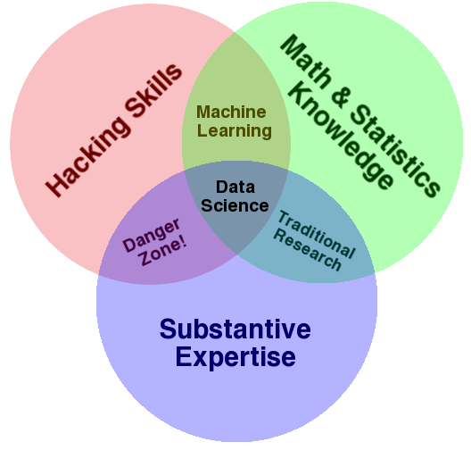
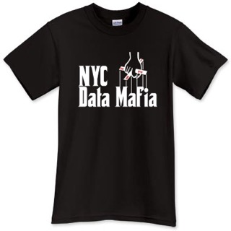
Drew Conway (2010)
YOU ARE HERE
FLASHBACK: Foundations of Data Science Session I
The Data Science Venn Diagram
Zero Intelligence Agents
Notes:
You need this background, but I am mindful of our constraints

Slide 36
The Data Science Pipeline
Data Ingestion
Data Munging and Wrangling
Computation and Analyses
STATISTICS
Reporting and Visualization
Modeling and Application
FLASHBACK: Foundations of Data Science Session I
Notes:
Because… Traditional takes on statistics talks about things like confidence intervals, hypothesis testing, etc etc. Statistics takes place all over the place!

Slide 37


Statistical Software

